Slide 1
Making this resource work for you
Prior to teaching this lesson, please refer to the ‘Unit Overview and Planning Document’.
Further guidance on planning Science Mastery lessons can be found in the detailed planning guidance document.
Refer to the ‘notes’ section on each slide for useful information, including suggested expositions, pedagogical content knowledge, suggested questions, answers and more. Consider using presenter mode so you can see this guidance throughout the lesson.
The introduction slides can be adapted to suit your teaching style and the needs of your class.
Before the lesson, adapt the fix-it slide to address any misconceptions identified in the previous lesson’s exit ticket.
Choose from the suggested activities to suit your class. The intention is not that you complete all of these, but that you select those which ones are most appropriate for your students. It may be appropriate to further adapt activities for your students.
These lessons are designed to occupy approximately 1 hour. To adapt for a shorter or longer lesson duration we advise you to adapt the activity section accordingly.
Please consider using the final slide to send feedback about this lesson or examples of PowerPoints that you have adapted to our design team. Your feedback is used to improve Science Mastery for all of our teachers and students. We appreciate all suggestions and comments.
Thank you for reading!
The Science Mastery Team

Slide 2
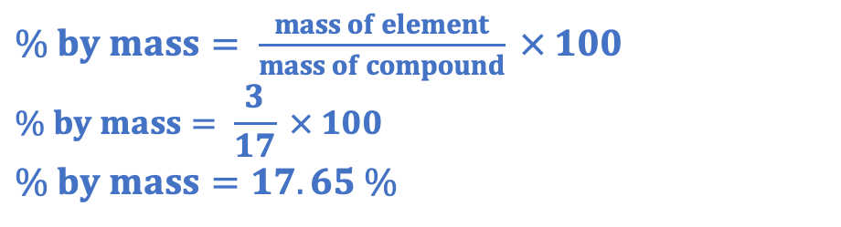
Introducing the Mole
Answer the questions below.
Define relative atomic mass.
Define relative formula mass.
Calculate the Mr of ammonia (NH₃). N=14, H=1
Calculate the Mr of calcium hydroxide (Ca(OH)₂). Ca=40, O=16, H=1
Calculate the percentage by mass of hydrogen in ammonia.
The average mass of atoms of an element compared to the mass of carbon-12.
The sum of the relative atomic masses of the elements in a compound.
14 + (3x1) =17
40 + 2(16+1) = 74
$\% by mass= \frac{mass of element}{mass of compound} × 100$
$$\% by mass= \frac{3}{17} × 100$$
$$\% by mass=17.65 \%$$
Notes:
Big idea: Reactions rearrange matter
Foundation: State the chemical symbol for carbon.
Stretch: Explain why some elements have an atomic mass that is not a whole number.
Answers:
Foundation: C
Stretch: Many elements have isotopes, which are different forms of the same element so have the same number of protons but different numbers of neutrons. The relative atomic mass is the average of the masses, taking into account the relative abundance of each.

Slide 3
Introducing the Mole
Do Now:
Define relative atomic mass.
Define relative formula mass.
Calculate the Mr of ammonia (NH₃). N=14, H=1
Calculate the Mr of calcium hydroxide (Ca(OH)₂). Ca=40, O=16, H=1
Calculate the percentage by mass of hydrogen in ammonia.
Drill:
Write 58230000 in standard form.
Convert 3.07 x10⁴ from standard form.
Write 0.0006 in standard form.
Notes:
Drill answers:
5.823 x 10⁷
30700
6 x 10⁻⁴

Slide 4
Introducing the Mole
Read Now:
In chemical reactions, there are a huge number (think many, many trillions!) of atoms in reactants that rearrange to form the products. Remember in a chemical reaction, mass is conserved, so no atoms are made or lost during a chemical reaction, only rearranged. So that scientists can keep track of the numbers of atoms involved in different substances without having to write out huge numbers, scientists use a quantity called ‘the mole’. As with many things in chemistry, we use carbon as the reference. 12 g of carbon contains 6.02 x10²³ atoms. This number of atoms is called Avogadro’s number and is the number of atoms in one mole. As a definition, we can say that a mole is the number of atoms contained in 12 g of carbon.
State the law of conservation of mass.
State Avogadro’s number.
Define a mole.
State the relative atomic mass of carbon.

Slide 5
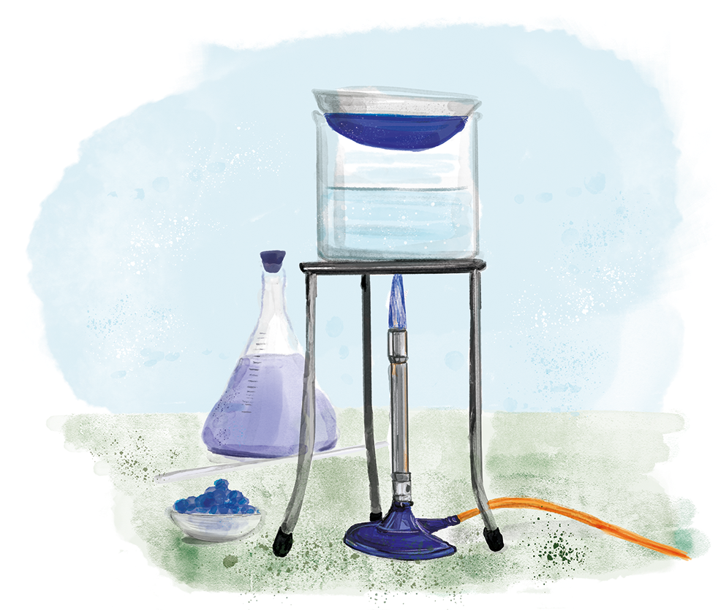
C4.3.2
03/02/2025
(HT) Introducing the Mole
C4.3.1 Prior Knowledge Review
C4.3.2 (HT) Introducing the Mole
C4.3.3 (HT) Mole Calculations
C4.3.4 PKR: Concentration
C4.3.5 TIF: Calculating Concentration
C4.3.6 TIF: Calculating an Unknown Concentration
C4.3.7 (HT) Amounts of Substances in Equations
C4.3.8 (HT) Limiting Reactants
C4.3.9 PKR: Reactions of Acids
C4.3.10 Acids, Alkalis and Neutralisation
C4.3.11 TIF: Acid-Alkali Titration
C4.3.12 TIF: Acid-Alkali Titration Analysis
C4.3.13 TIF: Titration Calculations
C4.3.14 (HT) Strong and Weak Acids
C4.3.15 TIF: Volumes of Gases
Notes:
Big idea: Reactions rearrange matter
In this lesson students will be introduced to the idea of the mole. In the next lesson they will apply the number of moles, mass and Mr calculation.
Suggested Hook:
How many atoms do you think there are in a glass of water?

Slide 6

Following this lesson, students will be able to:
State that 1 mole of a substance contains 6.02 x 10²³ particles.
Convert decimal numbers into standard form.
Calculate the mass of 1 mole of a substance.
Key Words:
mole
mass
amount
relative formula mass
Avogadro’s number
Notes:
Guidance:
See unit overview document and planning guidance to see how these objectives are typically assessed at GCSE, including examples of what students should be able to do following this lesson.
Planning for different needs:
The learning objectives given on this slide are suggested based on the most common requirements for exams, however they can be adapted based on the needs of different classes.
For best practice, the unit preparation booklet should be used to determine the appropriate focus of lessons within the unit.
While it is not possible to explicitly split content into levelled grades, we recommend that lesson objectives can be classified as critical, core or stretch.
Critical: the content or skill is essential for all students to be able to progress.
Core: the content or skill is important for students to progress, but other opportunities may be available to revisit it.
Stretch: the content or skill may not be essential for all students but is important for students aiming for the highest grades.
Key skill: this is a crucial skill being developed in this unit as part of the skill mapping
C4.3.2 Lesson Objectives:
Critical: State that 1 mole of a substance contains 6.02 x 10²³ particles.
Key skill: Convert decimal numbers into standard form.
Core: Calculate the mass of 1 mole of a substance.

Slide 7
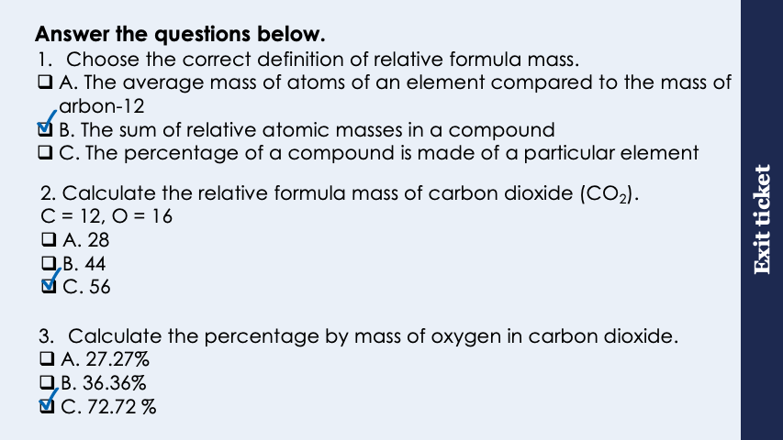
This is the fix-it portion of the lesson
The fix-it is an opportunity to respond to gaps in knowledge, especially those identified by the pre-unit quiz.
The teacher should customise this slide as needed, to facilitate
reteach, explanation, demonstration or modelling of ideas and concepts that students have not yet grasped or have misunderstood.
practise answering specific questions or of key skills.
redrafting or improving previous work.
Notes:
Purpose: to spend time on any gaps identified in previous learning from exit ticket.
Fix-it guidance from previous exit ticket:
Q1. Answer: B
If students answer A, they have confused Ar and Mr. To fix it, get students to write the definition of each and explain the difference between them. If students answer C, they have confused Mr and percentage by mass. To fix-it, review the definition of each with a model calculation.
Q2. Answer: B
If students answer A, they have just added the Ar of carbon and oxygen together without taking into account that there are two oxygen atoms. If students answer C, they have misinterpreted the meaning of the subscript and taken this to mean that there are two carbons and two oxygens. To fix-it, give students further practice of identifying the number of atoms of different elements in chemical formulae and calculating Mr.
If students answer C, this suggests a fundamental gap in knowledge about the function of stomata. To fix it, show students a diagram of a section through a leaf and describe how water loss and gas exchange happens at stomata. Then ask students why the function of stomata is so important for photosynthesis.
Q3. Answer: C
If students answer A, they have calculated the percentage by mass of carbon. If students answer B, they have only used the Ar of oxygen and not taken the two oxygens into account. To fix-it, give students lots of practice with percentage by mass calculations.

Slide 8
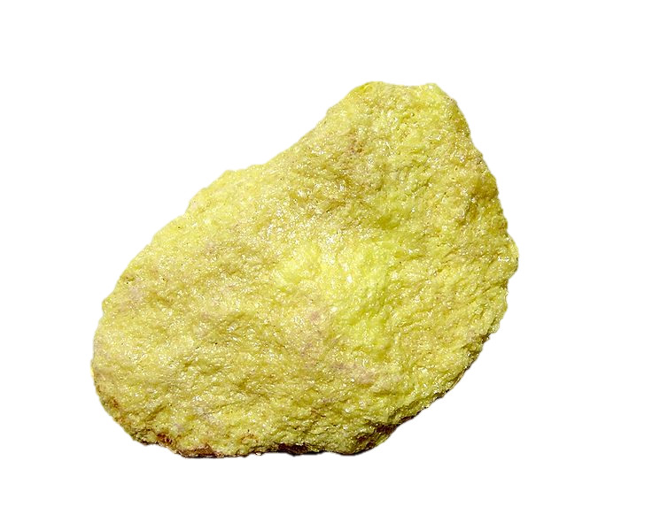
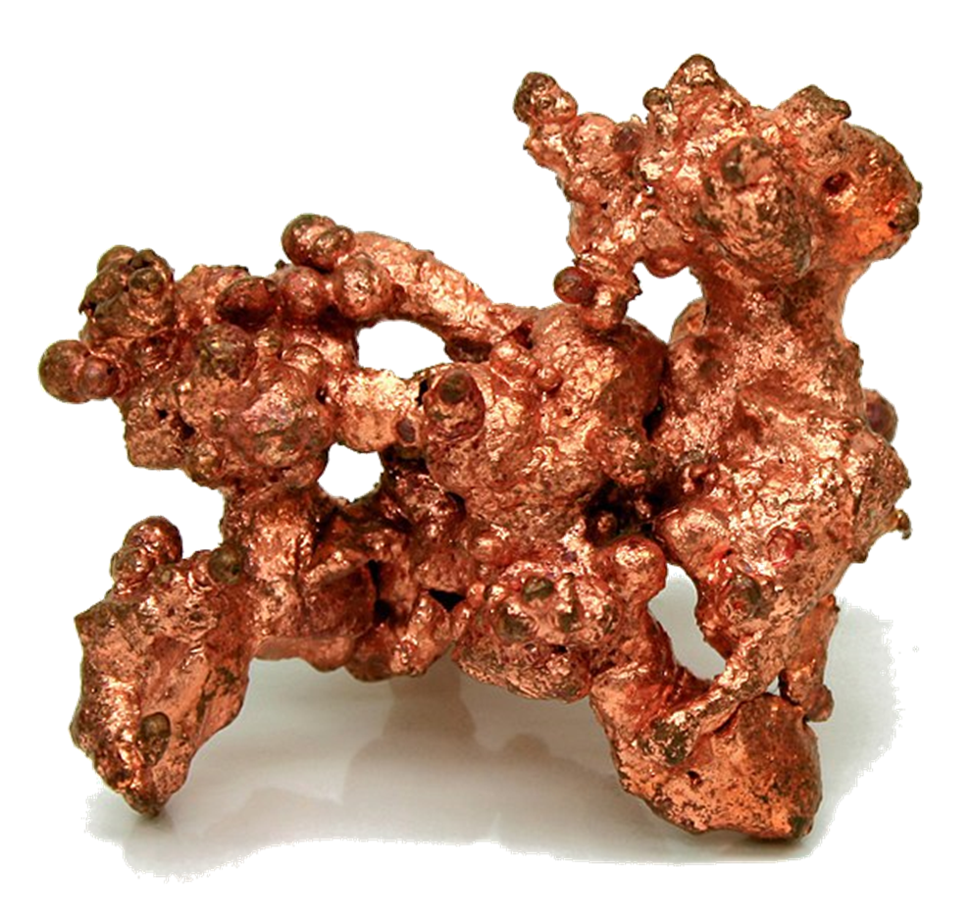
Is it possible to weigh one atom in a lab?
Imagine one atom of each element.
What would the ratio of the masses of these atoms be?
64 : 32 or 2 : 1
Is it possible to weigh one atom in our lab?
No, they are far too small. Chemists need to be able to compare masses that can be easily be measured.
Copper
Sulfur
Symbol | Cu | S
A_{r} | 64 | 32
Notes:
Exposition type: explanation
NOTE: Students struggle with the concept of moles – especially if it is treated purely as a mathematical concept.
This is the recommended teaching sequence from the Royal Society of Chemistry therefore there are a number of slides to go through – for more information please look at the CPD available on their website for Quantitative Chemistry https://www.rsc.org/cpd/resource/RES00001328/quantitative-chemistry
Suggested exposition:
Use your periodic tables to find the symbols and relative atomic masses of copper and sulfur.
The symbol for copper is Cu, not C as this is carbon! It has a relative atomic mass of 63.5. For the purposes of this explanation, we’re going to round this to 64.
Sulfur has the symbol S and a relative atomic mass of 32.
The spelling of sulfur is also accepted as sulphur. The traditional British spelling was sulphur, but the IUPAC now use sulfur (as do exam boards) so this is the spelling we will use.
Imagine one atom of each element. That is very hard to imagine, but try and imagine the smallest possible unit.
You may want to use the scale of the universe tool to help with this visualisation or show students the following video:
Link: https://www.youtube.com/watch?v=yQP4UJhNn0I
What would the ratio of the masses of these atoms be?
64:32, but if we make that the simplest possible ratio it would be 2:1.
That means a copper atom has twice the mass of a sulfur atom.
Is it possible to weigh (by which we mean take the mass of!) one atom in the lab?
No - they are far, far, far too small!
Guidance:
This works best if you have pre-weighed samples of well known elements and compounds in sealed containers labelled large enough for students to see, including the symbol/ formulae Ar/ Mr. Each sample should contain the molar mass of the substance e.g. 64g Copper; 32g Sulfur. You may already have these in the department.
Pick two and show them to the students – copper and sulfur have been used in this example, but can easily be changed to the substances you have available. Talk through the slide.
Have plasticine ‘atoms’ in the correct mass ratio, ensure students understand why Cu atom has a mass 64 and S atom a mass 32 – discuss the fact that it is the neutrons and protons that give the atoms mass and why one is heavier than the other.
Image source:
CC@https://commons.wikimedia.org/wiki/File:Native_Copper_Macro_Digon3.jpg

Slide 9
Is it possible to weigh one million atoms in a lab?
What would the ratio of masses be for the following numbers of atoms?
Even 1 000 000 atoms cannot be measured out in our lab!
The atoms are just too small.
Copper
Sulfur
Symbol | Cu | S
A_{r} | 64 | 32
Ratio of masses 1 atom | 2 | 1
2 | 1
100 atoms
1000 atoms
1 000 000 atoms
2 | 1
2 | 1
Notes:
Exposition type: explanation
Suggested exposition:
So we know that the ratio of the mass of copper to sulfur atoms is 2:1.
What would the ratio of the masses be if we had 100 atoms of each?
Still 2:1, we would have the same number of each type of atom, but each copper atom still has twice the mass of each sulfur atom.
What about 1000 atoms?
Still 2:1!
What about 1 000 000 atoms??
Still 2:1
Even as we have millions of atoms, if we have the same number of atoms in a sample of copper and a sample of sulfur, their masses will still be in the ratio 2:1. This means that whatever number of atoms we have (the same for both copper and sulfur) the mass of the copper will always be twice that of the mass of sulfur, because each individual copper atom has twice the mass of each sulfur atom.

Slide 10

Is this correct?
Yes! There are the same number of atoms in 64 g of Cu as in 32 g of S.
64g of Copper contains the same number of atoms as 32 g of sulfur.
Copper
Sulfur
Symbol | Cu | S
A_{r} | 64 | 32
Ratio of masses | 2 | 1
Mass in grams
64 g | 32 g
Notes:
Suggested guidance:
Talk tasks can be used in a variety of ways to suit the particular needs of the students you are teaching. Through exchanging views with others, students develop their understanding of the science beyond what could be achieved individually.
Science classrooms that successfully integrate talk have the following features:
Science talk is a regular feature of lessons and is woven into classroom activities.
Students are paired or grouped strategically by the teacher to ensure productive interaction. This might take into consideration the students’ proficiency of the English language, how encouraging they might be to peers and their attainment in the topic. It’s a good idea to consider these pairings in the class seating plan.
Students are encouraged and supported to talk, but are not forced to talk.
The teacher should take on the role of a facilitator, engaging with conversations where necessary and encouraging or steering the conversation where needed.
Students are encouraged to use the language they have to express their ideas (e.g., everyday language, imperfect English, native language), but also to incorporate science specific terminology where this is more accurate or has been taught.
6. Scientifically inaccurate ideas are not dismissed by the partner or teacher; open discussion and further investigation are relied on to help students construct ideas that support them to progress in their scientific understanding.
7. Guidelines for behaviour during talk tasks are explicit and frequently reviewed. Rules for students might be:
Listen carefully to your partner
Take turns talking.
Speak one at a time, without interrupting.
Politely agree or disagree and explain why.
Politely point out if your partner has used a scientific word incorrectly, if they have explained the science incorrectly, or if there is a more accurate way to describe something.
If confused, ask questions.
Stay focused on the discussion topic.
Respond to one another.
Lesson notes:
Refer to the labels on the jars of the elements – clearly it is possible to measure out amounts of chemicals in our lab, but how have chemists done this? What is special about these amounts?
Now click to add the masses in grams to the table.
Ask students for the ratio of the masses 2:1
Now ask the key question What can you say about the numbers of atoms in the two jars? BE PATIENT! Eventually someone should make the connection between the ratio of the relative masses of the atoms and the ratio of the actual masses.

Slide 11
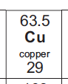
How small are atoms?
Atoms are extremely small.
The number of atoms present in a lump of copper is extremely large.
The relative atomic mass (63.5 for copper) tells you the mass of copper (in grams) that contains exactly 602,000,000,000,000,000,000,000 atoms!
This is the same for every element! It’s relative atomic mass tells you the mass of that element that contains exactly 602,000,000,000,000,000,000,000 atoms.
12 g of carbon contains 602,000,000,000,000,000,000,000 atoms.
16 g of oxygen contains 602,000,000,000,000,000,000,000 atoms.
1 g of Hydrogen contains 602,000,000,000,000,000,000,000 atoms.
Copper
Notes:
Exposition type: explanation
Suggested exposition:
Atoms are extremely small. It is so difficult for us to even comprehend how small! Because individual atoms themselves are so small, this means that the number of atoms present in a lump of copper that we can see or hold is extremely large.
The relative atomic mass of an element (so for copper this is 63.5) tells you the mass of the element in grams that contains 602,000,000,000,000,000,000,000 atoms. This is nearly a trillion trillion, but this is an enormous number. If we counted every single grain of sand on Earth 100,000 times, we would be nearly at the scale of this number, that is how big it is. And this number of atoms fit inside a 63.5 g chunk of copper - that is how small atoms are!
So the relative atomic mass of an element tells you the mass in grams of that element that would contain this number of atoms.
The relative atomic mass of carbon is 12, so 12 g of carbon would contain this many atoms.
The relative atomic mass of oxygen is 16, so 16 g of carbon would contain this many atoms.
The relative atomic mass of hydrogen is 1, so 1 g of carbon would contain this many atoms.
Guidance:
Take your time working through this slide with pupils. This is a crucial part of Chemistry which students often have trouble understanding. Take some more examples from the periodic table to really drive this point home for students. Have students look up elements in their own copy of the periodic table. Use the term relative atomic mass to link to the previous lesson.

Slide 12
Standard Form
Numbers such as 602,000,000,000,000,000,000,000 can be written in standard form to make them easier to work with.
602,000,000,000,000,000,000,000 can be written as 6.02 x 10²³
All numbers in standard form look like this:
6.02 x 10²³
Exponent (23)
Coefficient (6.02)
Multiplication sign (times)
Base (10)
Notes:
Exposition type: explanation
Suggested exposition:
This number is so big that it would be a nightmare to write it out every time, and would be extremely likely that we would miss a zero somewhere.
When working with very large numbers, like numbers of atoms or distances in space, or very small numbers, like the size of atoms, we can use standard form to make them easier to work with.
All numbers in standard form look like this. They have one digit between 1 and 10, followed by the decimal place then a multiplication sign, the base 10 and the exponent.
Possible video to support writing in standard form:
https://www.bbc.co.uk/bitesize/guides/zxsv97h/video

Slide 13
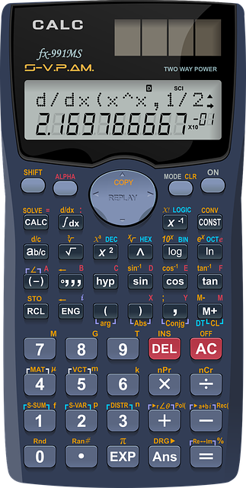
Writing standard form into a scientific calculator
For 6.02 x 10²³, type 6.02, then press the button in the picture, then press 23.
Notes:
It is good to practice this with students as it may have been a while since they worked with standard form on a calculator. Other versions of calculations may have different buttons so it is worth getting all students to work out the correct buttons on their own calculators.

Slide 14
Converting a number to standard form
Move the decimal point along until these is just one digit to the left of the decimal point. Start with the number x 10⁰
If the decimal point moves left
If the decimal point moves right
The exponent goes up
The exponent goes down
Examples:
157030.00
849000000
0.000000007
1.5703 x 10⁵
8.49 x 10⁸
7 x 10⁻⁹
Notes:
Gives some examples on the board of both very large and very small numbers being converted to standard form.
Narrate for students as you work through the process. Students will have an opportunity to practice this in the activity section of the lesson.

Slide 15
Question 1: Which is bigger?
They are both the same size! They both equal 23800000000
Remember: Standard form is written in the form of a×10^{n}, where a is a number bigger than or equal to 1 and less than 10.
2.38 x 10¹⁰
✓
or
23.8 x 10⁹
✗
Question 2: Which number shows the correct way to write standard form?
The first number is correct, because there should always be just one number before the decimal point when writing standard form.
Notes:
Suggested guidance:
Talk tasks can be used in a variety of ways to suit the particular needs of the students you are teaching. Through exchanging views with others, students develop their understanding of the science beyond what could be achieved individually.
Science classrooms that successfully integrate talk have the following features:
Science talk is a regular feature of lessons and is woven into classroom activities.
Students are paired or grouped strategically by the teacher to ensure productive interaction. This might take into consideration the students’ proficiency of the English language, how encouraging they might be to peers and their attainment in the topic. It’s a good idea to consider these pairings in the class seating plan.
Students are encouraged and supported to talk, but are not forced to talk.
The teacher should take on the role of a facilitator, engaging with conversations where necessary and encouraging or steering the conversation where needed.
Students are encouraged to use the language they have to express their ideas (e.g., everyday language, imperfect English, native language), but also to incorporate science specific terminology where this is more accurate or has been taught.
6. Scientifically inaccurate ideas are not dismissed by the partner or teacher; open discussion and further investigation are relied on to help students construct ideas that support them to progress in their scientific understanding.
7. Guidelines for behaviour during talk tasks are explicit and frequently reviewed. Rules for students might be:
Listen carefully to your partner
Take turns talking.
Speak one at a time, without interrupting.
Politely agree or disagree and explain why.
Politely point out if your partner has used a scientific word incorrectly, if they have explained the science incorrectly, or if there is a more accurate way to describe something.
If confused, ask questions.
Stay focused on the discussion topic.
Respond to one another.

Slide 16
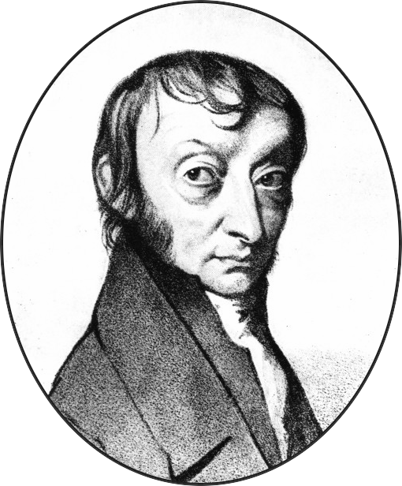
Avogadro’s number
We can write the number 602,000,000,000,000,000,000,000 as 6.02 x 10²³
This number is called Avogadro’s number or the Avogadro constant.
We call this number and the physical amount of this material 1 mole (unit= mol).
1 mole = 6.02 x 10²³ particles in the same way that 1 dozen = 12.
We can say that in 63.5g of Cu there are 6.02 x 10²³ atoms OR 63.5g is 1 mole of Cu.
Notes:
Exposition type: explanation
Suggested exposition:
We use different words to describe certain quantities. For example, 1 dozen eggs means 12 eggs. 1 pair of shoes means 2 shoes. Score is old-fashioned language for 20 (like Abraham Lincoln’s Gettysburg address fourscore and seven years ago, meaning 87).
In the same way, this number of 6.02 x1023 is Avogadro’s number. We use it in the same way. We can say that Avogadro’s number (6.02 x 1023) is one mole.
So in 63.5 g of copper there are 6.02 x 1023 atoms, but we can also say that in 63.5 g of copper, there is one mole. We use the unit mol for moles, in the same way that we use g for grams or m for metres.
How many atoms would there be in 12 g of carbon?
The relative atomic mass of carbon is 12, so in 12 g of carbon there would be 6.02 x 1023 atoms.
How many is this in moles?
In 12 g of carbon, there is one mole.
We can use Avogadro’s number to talk about the number of atoms, ions or molecules. It just depends on the substance we are talking about. So one mole of carbon dioxide would contain 6.02 x 10²³ molecules of carbon dioxide (and therefore 3 x 6.02 x10²³ atoms). One mole of oxygen gas would contain 6.02 x 10²³ molecules of oxygen so 2 x 6.02 x 10²³ atoms.
Notes:
1 mole of any substance = 6.02 x 10²³ particles (also called Avogadro’s number of particles).
This equals the relative atomic mass (or relative formula mass if you’re talking about a compound.)
The mole, symbol mol, is the unit for amount of substance, in the same way the metre is the unit for length.
The number of particles in one mole is called the Avogadro constant which equals 6.02 x 10²³. By particles, we can mean atoms, molecules, ions, electrons or any other particle. It depends upon the substance you are talking about.
This works really well if you have samples of 1 mol of different substances to hand to show students. 12 g of C in a pot has the same number of atoms as 24 g of Magnesium.
Teacher subject knowledge:
It is important to be careful with language at this stage. There is a new definition of the mole which was implemented on 20th May 2019. This means many textbooks have the earlier 1971 definition that refers to carbon-12. https://iupac.org/new-definition-mole-arrived/
New definition: The mole, symbol mol, is the SI unit of amount of substance. One mole contains exactly 6.02214076 × 10²³ elementary entities. This number is the fixed numerical value of the Avogadro constant, N_{A}, when expressed in mol⁻¹, and is called the Avogadro number.
The amount of substance, symbol n, of a system is a measure of the number of specified elementary entities. An elementary entity may be an atom, a molecule, an ion, an electron, any other particle or specified group of particles. https://www.degruyter.com/view/journals/pac/90/1/article-p175.xml
Possible videos:
https://www.youtube.com/watch?v=CPR9eZBpCW4
https://www.youtube.com/watch?v=TEl4jeETVmg

Slide 17


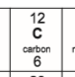
True or false?
One mole of carbon contains the same number of atoms as one mole of copper.
1 gram of carbon contains the same number of atoms as 1 gram of copper.
Atoms are very small.
6 g of carbon contains the same number of atoms as 29 g of copper.
The symbol for the unit mole is mol.
1 mole of carbon contains 6.02 x 10²³ atoms.
The number of atoms present in an object are very small.
12 g of carbon contain the same number of atoms as 63.5 g of copper.
True False
Notes:
1. T; 2. F; 3. T; 4. F; 5. T; 6. T; 7. F; 8. T

Slide 18
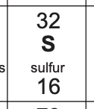
How many moles?
The relative formula mass of sulfur is 32.
How many atoms would there be in 32 g of sulfur?
How many moles are there in 32 g of sulfur?
How many atoms would there be in 64 g of sulfur?
How many moles would there be in 64 g of sulfur?
Notes:
Suggested points:
In 32 g of sulfur there would be 6.02 x10²³ atoms.
In 32 g of sulfur there would be one mole.
In 64 g of sulfur (this is twice the relative formula mass, so there would be twice as many atoms), there would be 1.204 x 10²⁴.
In 64 g of sulfur there would be two moles.
Suggested guidance:
Talk tasks can be used in a variety of ways to suit the particular needs of the students you are teaching. Through exchanging views with others, students develop their understanding of the science beyond what could be achieved individually.
Science classrooms that successfully integrate talk have the following features:
Science talk is a regular feature of lessons and is woven into classroom activities.
Students are paired or grouped strategically by the teacher to ensure productive interaction. This might take into consideration the students’ proficiency of the English language, how encouraging they might be to peers and their attainment in the topic. It’s a good idea to consider these pairings in the class seating plan.
Students are encouraged and supported to talk, but are not forced to talk.
The teacher should take on the role of a facilitator, engaging with conversations where necessary and encouraging or steering the conversation where needed.
Students are encouraged to use the language they have to express their ideas (e.g., everyday language, imperfect English, native language), but also to incorporate science specific terminology where this is more accurate or has been taught.
6. Scientifically inaccurate ideas are not dismissed by the partner or teacher; open discussion and further investigation are relied on to help students construct ideas that support them to progress in their scientific understanding.
7. Guidelines for behaviour during talk tasks are explicit and frequently reviewed. Rules for students might be:
Listen carefully to your partner
Take turns talking.
Speak one at a time, without interrupting.
Politely agree or disagree and explain why.
Politely point out if your partner has used a scientific word incorrectly, if they have explained the science incorrectly, or if there is a more accurate way to describe something.
If confused, ask questions.
Stay focused on the discussion topic.
Respond to one another.

Slide 19
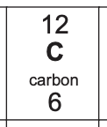
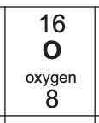
How many atoms?
How many atoms would there be in 12 g of carbon?
What is the relative formula mass of carbon dioxide?
How many molecules of carbon dioxide would there be in 44 g?
How many atoms would there be in 44 g of carbon dioxide?
Notes:
Suggested points:
In 12 g of carbon there would be 6.02 x10²³ atoms.
Relative formula mass of carbon dioxide is 44.
In 44 g of carbon dioxide, there would be one mole, or 6.02 x 10²³ molecules.
Each molecule contains 3 atoms (1 carbon and 2 oxygen), so there are 3 x 6.02 x1023 atoms! = 1.806 x10²⁴
Suggested guidance:
Talk tasks can be used in a variety of ways to suit the particular needs of the students you are teaching. Through exchanging views with others, students develop their understanding of the science beyond what could be achieved individually.
Science classrooms that successfully integrate talk have the following features:
Science talk is a regular feature of lessons and is woven into classroom activities.
Students are paired or grouped strategically by the teacher to ensure productive interaction. This might take into consideration the students’ proficiency of the English language, how encouraging they might be to peers and their attainment in the topic. It’s a good idea to consider these pairings in the class seating plan.
Students are encouraged and supported to talk, but are not forced to talk.
The teacher should take on the role of a facilitator, engaging with conversations where necessary and encouraging or steering the conversation where needed.
Students are encouraged to use the language they have to express their ideas (e.g., everyday language, imperfect English, native language), but also to incorporate science specific terminology where this is more accurate or has been taught.
6. Scientifically inaccurate ideas are not dismissed by the partner or teacher; open discussion and further investigation are relied on to help students construct ideas that support them to progress in their scientific understanding.
7. Guidelines for behaviour during talk tasks are explicit and frequently reviewed. Rules for students might be:
Listen carefully to your partner
Take turns talking.
Speak one at a time, without interrupting.
Politely agree or disagree and explain why.
Politely point out if your partner has used a scientific word incorrectly, if they have explained the science incorrectly, or if there is a more accurate way to describe something.
If confused, ask questions.
Stay focused on the discussion topic.
Respond to one another.

Slide 20
Drill
State the relative atomic mass of carbon.
State Avogadro’s number.
State how many atoms would be in 12 g of carbon.
State how many moles would be in 12 g of carbon.
State the relative atomic mass of calcium.
State how many atoms would be in 40 g of calcium.
State how many moles would be in 40 g of calcium.
Notes:
Purpose: This is a knowledge drill. The purpose of this is to check that the critical knowledge is secure before pupils move onto independent practice.
Suggested guidance: There are a range of ways this could be done depending on time and ability range of the class:
Mini whiteboards
As full sentences in exercise books
As short answers in exercise books
In the pupil workbook
As pair talk
As cold call

Slide 21
Drill answers
12
6.02 x 10²³
6.02 x 10²³
1 mole
40
6.02 x 10²³
1 mole
Notes:
Purpose: This is a knowledge drill. The purpose of this is to check that the critical knowledge is secure before pupils move onto independent practice.
Suggested guidance: There are a range of ways this could be done depending on time and ability range of the class:
Mini whiteboards
As full sentences in exercise books
As short answers in exercise books
In the pupil workbook
As pair talk
As cold call

Slide 22
Complete the table to convert numbers to standard form.
Decimal | Standard Form (Scientific Notation)
67,000,000,000
40,000,000,000,000,000
4,300,000
65,430,000
0.00000000004
0.0000000654
0.002
6.7 x 10¹⁰
4 x 10¹⁶
4.3 x 10⁶
6.543 x 10⁷
4 x 10⁻¹¹
6.54 x 10⁻⁸
2 x 10⁻³
Notes:
This table is on a worksheet for printing if needed.

Slide 23

I: Moles and atoms
One mole of any substance contains 6.02 x 10²³ atoms or molecules of that substance.
What is the chemical formula for water?
H₂O
What is the relative formula mass of water?
2 x 1 + 16 = 18
What mass in grams would contain 6.02 x 10²³ molecules of water?
18 g
What mass in grams would contain one mole of water?
18 g
Stretch: what mass in grams would contain two moles of water?
36 g
Notes:
Purpose: The I-We-You section aims to support pupils to build skills that they most commonly need when answering questions associated with this knowledge in the assessment. This section is also used to interleave other content we expect pupils to know at this stage of their education in order that they build a big picture of the science they are learning.
For the ‘I’ activity, the teacher should model how to answer the question. They can do this by narrating their thinking process aloud, and making links to learning earlier in the lesson explicit.
For the ‘we’ activity, the teacher and students work though a similar example together, in order to prepare students to be able to answer a similar question independently.
Opportunities for the ‘you’ activity – independent practise – occur in the activity portion of the lesson once the student is secure enough to process independently.

Slide 24
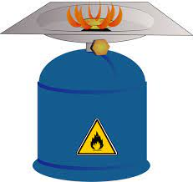
We: Moles and atoms
One mole of any substance contains 6.02 x 10²³ atoms or molecules of that substance.
Methane has the chemical formula CH₄.
What is the relative formula mass of methane?
12 + (4 x 1) = 16
What mass in grams would contain 6.02 x 10²³ molecules of methane?
16 g
What mass in grams would contain one mole of methane?
16 g
Stretch: what mass in grams would contain two moles of methane?
32 g
Notes:
Purpose: The I-We-You section aims to support pupils to build skills that they most commonly need when answering questions associated with this knowledge in the assessment. This section is also used to interleave other content we expect pupils to know at this stage of their education in order that they build a big picture of the science they are learning.
For the ‘I’ activity, the teacher should model how to answer the question. They can do this by narrating their thinking process aloud, and making links to learning earlier in the lesson explicit.
For the ‘we’ activity, the teacher and students work though a similar example together, in order to prepare students to be able to answer a similar question independently.
Opportunities for the ‘you’ activity – independent practise – occur in the activity portion of the lesson once the student is secure enough to process independently.

Slide 25
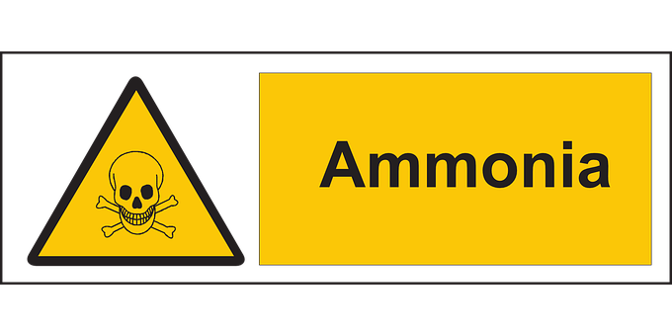
You: Moles, molecules and atoms
One mole of any substance contains 6.02 x 10²³ atoms or molecules of that substance.
Ammonia has the chemical formula NH₃.
What is the relative formula mass of ammonia?
14 + (3 x 1) = 17
What mass in grams would contain 6.02 x 10²³ molecules of ammonia?
17 g
What mass in grams would contain one mole of ammonia?
17 g
Stretch: what mass in grams would contain two moles of methane?
34 g
Stretch: how many atoms are there in one mole of ammonia?
Each ammonia molecule contains 4 atoms, so 4 x 6.02 x 10²³ = 2.408 x 10²⁴ atoms
Notes:
Purpose: The I-We-You section aims to support pupils to build skills that they most commonly need when answering questions associated with this knowledge in the assessment. This section is also used to interleave other content we expect pupils to know at this stage of their education in order that they build a big picture of the science they are learning.
For the ‘I’ activity, the teacher should model how to answer the question. They can do this by narrating their thinking process aloud, and making links to learning earlier in the lesson explicit.
For the ‘we’ activity, the teacher and students work though a similar example together, in order to prepare students to be able to answer a similar question independently.
Opportunities for the ‘you’ activity – independent practise – occur in the activity portion of the lesson once the student is secure enough to process independently.

Slide 26
Elemental cards and moles in equations
In a balanced symbol equation the number in front of the formula tells you the amount of that substance that is reacting, in moles.
2H₂ + O₂ → 2H₂O
Two moles of hydrogen react with one mole of oxygen to form 2 moles of water.
How many molecules are there in one mole of O₂?
6.02 x 10²³ molecules of O₂
Describe the following equation in words.
C + O₂ → CO₂
One mole of carbon reacts with one mole of oxygen gas to form one mole of carbon dioxide.
Remember: Avogadro’s constant = 6.02 x 10²³
Notes:
Purpose: students practise using and applying their new knowledge. Mark schemes are given where possible for students to self or peer assess work.
Answers: Mr H₂ = 2; Mr O₂ = 32; Mr H₂O = 18; Mr CO₂ = 44; 2H₂ + O₂ → 2H₂O; C + O₂ → CO₂
NOTE: This first activity is recommended to be completed at this stage by the Royal Society of Chemistry – for more information please look at the CPD available on their website for Quantitative Chemistry https://www.rsc.org/cpd/resource/RES00001328/quantitative-chemistry
Lesson notes: Ensure there are enough cards for students to experiment producing different substances – please note this is a very simplified activity. During the activity – keep reinforcing the ideas that new substances are made and that mass is conserved. The cards can be invaluable when working with students of all abilities.
Formula cards: Each card has the symbol and Ar for the element.
Make elements with ‘one combining power’ square shaped, then double and triple length for elements with combing powers of 2 and 3.
Students can then make the formulae of simple compounds e.g. water, by aligning two H cards with one O card.
Encourage students to construct a simple equation and write it correctly based on the formulae they have made with the cars. They will then also be able to see that the large numbers in front of formulae represent the number of moles present.
The RSC suggests using these cards to construct equations to help understand balancing and to use them every time students meet a new chemical reaction.
They help students see that the relative formula mass values, Mr, of elements and compounds are the sums of the Ar values of the component elements – reinforcing the concept and acting as an interleaving exercise.

Slide 27
Elemental cards and moles in equations
The formula cards have the symbol for the element and its relative atomic mass (A_{r}).
Use the cards to form a molecule of hydrogen gas and a molecule of oxygen gas. What is the M_{r} of H₂? What is the Mr of O₂?
Now use the cards to form a molecule of water and a molecule of carbon dioxide. What is the M_{r} of H₂O? What is the M_{r} of CO₂?
Use the cards to form a balanced equation for the formation of water from O₂ and H₂. Remember there needs to be the same number of atoms of each element on both sides of the equation and M_{r} products = M_{r} reactants.
If you have time – repeat for the formation of carbon dioxide from carbon and oxygen gas.
Notes:
Purpose: students practise using and applying their new knowledge. Mark schemes are given where possible for students to self or peer assess work.
Answers: Mr H₂ = 2; Mr O₂ = 32; Mr H₂O = 18; Mr CO₂ = 44; 2H₂ + O₂ → 2H₂O; C + O₂ → CO₂
NOTE: This first activity is recommended to be completed at this stage by the Royal Society of Chemistry – for more information please look at the CPD available on their website for Quantitative Chemistry https://www.rsc.org/cpd/resource/RES00001328/quantitative-chemistry
Lesson notes: Ensure there are enough cards for students to experiment producing different substances – please note this is a very simplified activity. During the activity – keep reinforcing the ideas that new substances are made and that mass is conserved. The cards can be invaluable when working with students of all abilities.
Formula cards: Each card has the symbol and Ar for the element.
Make elements with ‘one combining power’ square shaped, then double and triple length for elements with combing powers of 2 and 3.
Students can then make the formulae of simple compounds e.g. water, by aligning two H cards with one O card.
Encourage students to construct a simple equation and write it correctly based on the formulae they have made with the cars. They will then also be able to see that the large numbers in front of formulae represent the number of moles present.
The RSC suggests using these cards to construct equations to help understand balancing and to use them every time students meet a new chemical reaction.
They help students see that the relative formula mass values, Mr, of elements and compounds are the sums of the Ar values of the component elements – reinforcing the concept and acting as an interleaving exercise.

Slide 28
Answer the questions below.
Which of the following is true?
A. The symbol for mole is mol.
B. The symbol for mole is moles.
C. The symbol for moles is m.
✓
How many molecules in 1 mole of CO₂?
A. 44
B. 6.02 x10²³
C. 1
✓
Which number is the same as 6 x 10³?
A. 60300
B. 63000
C. 6000
✓
Notes:
Q1. Answer: A
If students answer B or C, they have not identified the units for moles. To fix-it, review the definition and the units. .
Q2. Answer: B
If students answer A, suggests the student is confusing ‘number of molecules’ with the relative formula mass. To fix it, give students some compounds and elements and ask them to identify the RFM for each. If students answer C, they have misinterpreted the meaning of mole, so have suggested that there is 1 mole in a mole, but the question is asking about the number of molecules. To fix-it, give students further practice of identifying the number of atoms in 1 mole of different elements and compounds.
Q3. Answer: C
If students answer A or B, it shows the need more practice of standard form conversions. To fix-it, give students more practice of converting between written out numbers and standard form.

Slide 29
Lesson C4.3.2
What was good about this lesson? | What can we do to improve this lesson?
Send us your feedback by clicking this link
or by emailing sciencemastery@arkonline.org
Thank you!

